Slide 1
Building Social Infrastructure: Sectoral Opportunities in the next decade
Key relationship planks?
Robyn Keast PhD, MA

Slide 2
Infrastructure Trilogy
National development/social benefits conventionally achieved through investment in ‘hard’ physical infrastructure
Roads, rail, airports, bridges, ports, telecommunication networks, utilities
Soft infrastructure as the ‘safety net’
Housing, education, health, support services , cultural, philanthropic bodies, festivals, social events
Provide sense of community & underwrites social stability/quality of life
BUT: emphasis has been on hard & soft infrastructures –
Social/Relational infrastructure (social capital) – the glue that binds - ignored, down-played, under-valued
Facilitates social bonds, access knowledge & mobilise resources
Also provides a critical link to hard and soft infrastructures
Need to take account of & facilitate social connections – relationships – the intangibles!

Slide 3
The good news
Sector has long history of working together – good relationships
Comprised of people with relational skills & ethos
Experimented with & perfected models & approaches
Enormous social /network capital reserves
Togethering is in DNA!

Slide 4
The bad news
The push for tight connections /relations
Transaction costs & take attention away from ‘real work’
Wrong connections
Without resources, information, influence
Not strategic
People know and like – just like ‘us’ but they don’t always deliver
Toxic!
Over-investing in existing relationships
Over-reliance on personal social/network capitals

Slide 5
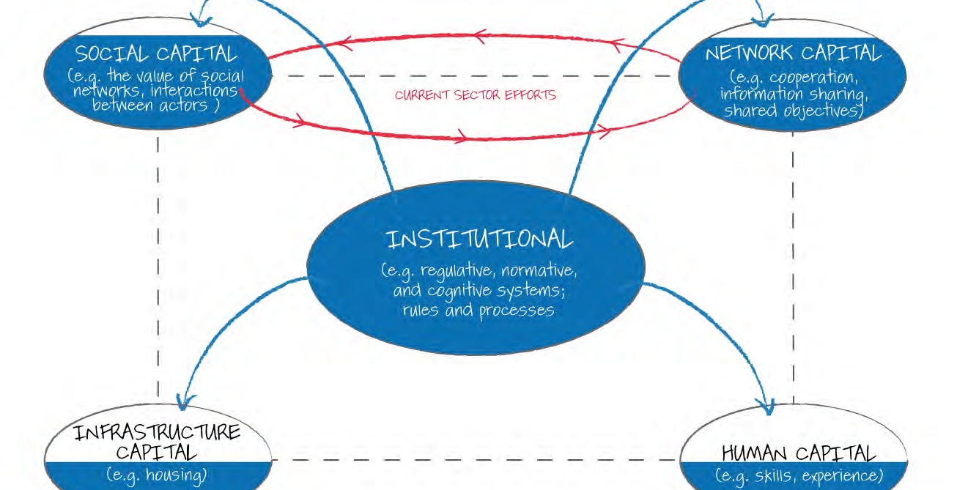

Slide 6
The Holy Grail of Collaboration
Contemporary social challenges require even more cross-departmental, organisational, disciplinary and sectoral responses/relationships
BUT:
Coordination & especially collaboration have proven hard to achieve & harder to sustain
50-70% collaborations fail to reach potential
Wrong form, wrong people/partners, poor implementation, unexpected costs

Slide 7
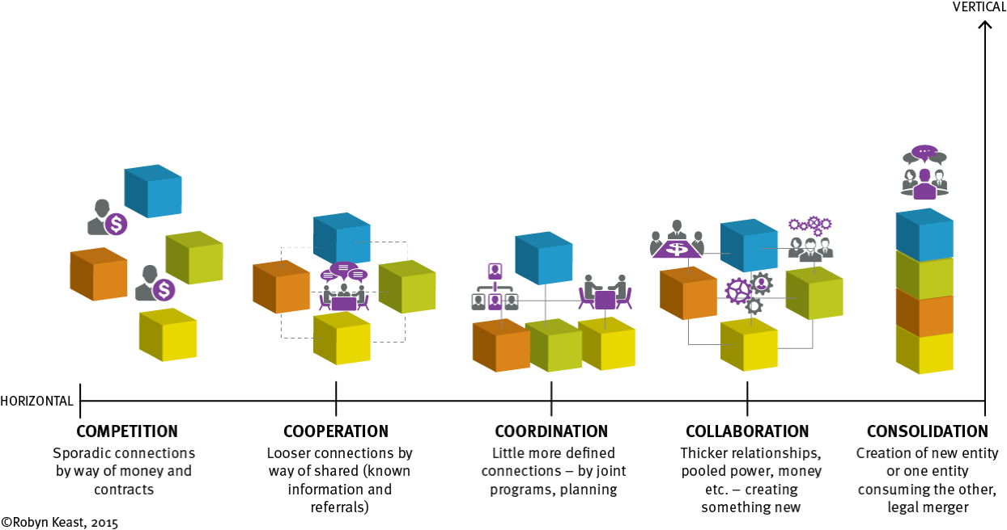
Relationship Continuum

Slide 8
Fit for purpose
All 5Cs relations have merit & application
Approaches & relational strength must be requisite to purpose
What do you want to achieve?
Independent, adjusting actions & information sharing: cooperation
Do same, but more efficiently through joint working, aligned resources & action: coordination
Systems change, transformation: collaboration
Collaboration Decision Support Tool – QCOSS

Slide 9
Nurturing & leveraging relationships
Takes time 3 – 5 years – not short-term investment Deliberate & strategic
Assess your relationships – strength & quality
Nurture new & look after existing
Scale down when needed
Resource to be leveraged/not exploited
Not all cups of tea and a bit of a chat!
Be prepared to take risks & give space to let the synergies work
Don’t be a ‘blue box thinker’ – privilege process over position & power

Slide 10
Relationships with funders
Old & new sources & relationships (government, business)
Each with different ideology, functions, expectations and relational approaches
Effective ‘togethering’ relationships requires understanding the motivations, objectives, aspirations, restrictions and tactics of ‘partners’
There is no quick fix or ideal partnership
Requires constant work - dialogue, monitoring/review & adjustments to remain viable & relevant

Slide 11
Connecting: Top Points
Know
your options (range of relationships available)
Know
your connections (strength & quality of relationships
Be
strategic & deliberate in relational actions
Be
a Value Adding Connector - not just a connector

Slide 12
Social Infrastructure
Network Infrastructure
Institutional Infrastructure
Social Infrastructure, based on personal relationships and interpersonal interactions that build the robust connections and core competencies necessary for ongoing collaboration.
Sustaining Social/relational Infrastructures
Organisational direction, leadership, systems, culture and processes designed to improve & support and maintain relational/collaborative endeavour, practices and skills.
Supportive (internal & external) structures ranging from small cells, to clusters and networks that build a critical mass particular areas & can be leveraged for future shared outcomes.
Relationships

Slide 13
Pulling it all together?
Sustained economic & social benefits based on mix hard, soft & relational infrastructures
Relationships don’t happen by magic, take investment of effort & time & can be risky
Many new relational options are available – fit for purpose & implemented genuinely
Not ‘magic’ or ‘business as usual’
Requires strategic deliberative relational decisions & actions to be successful & sustained as well as supporting sub-structures)

